Slide 1
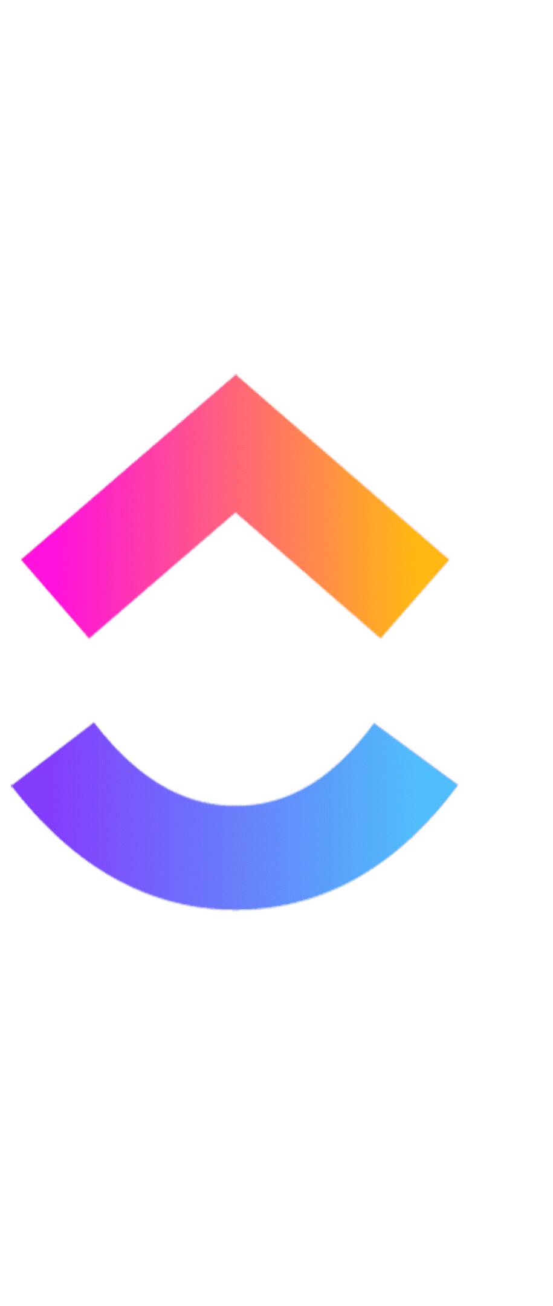
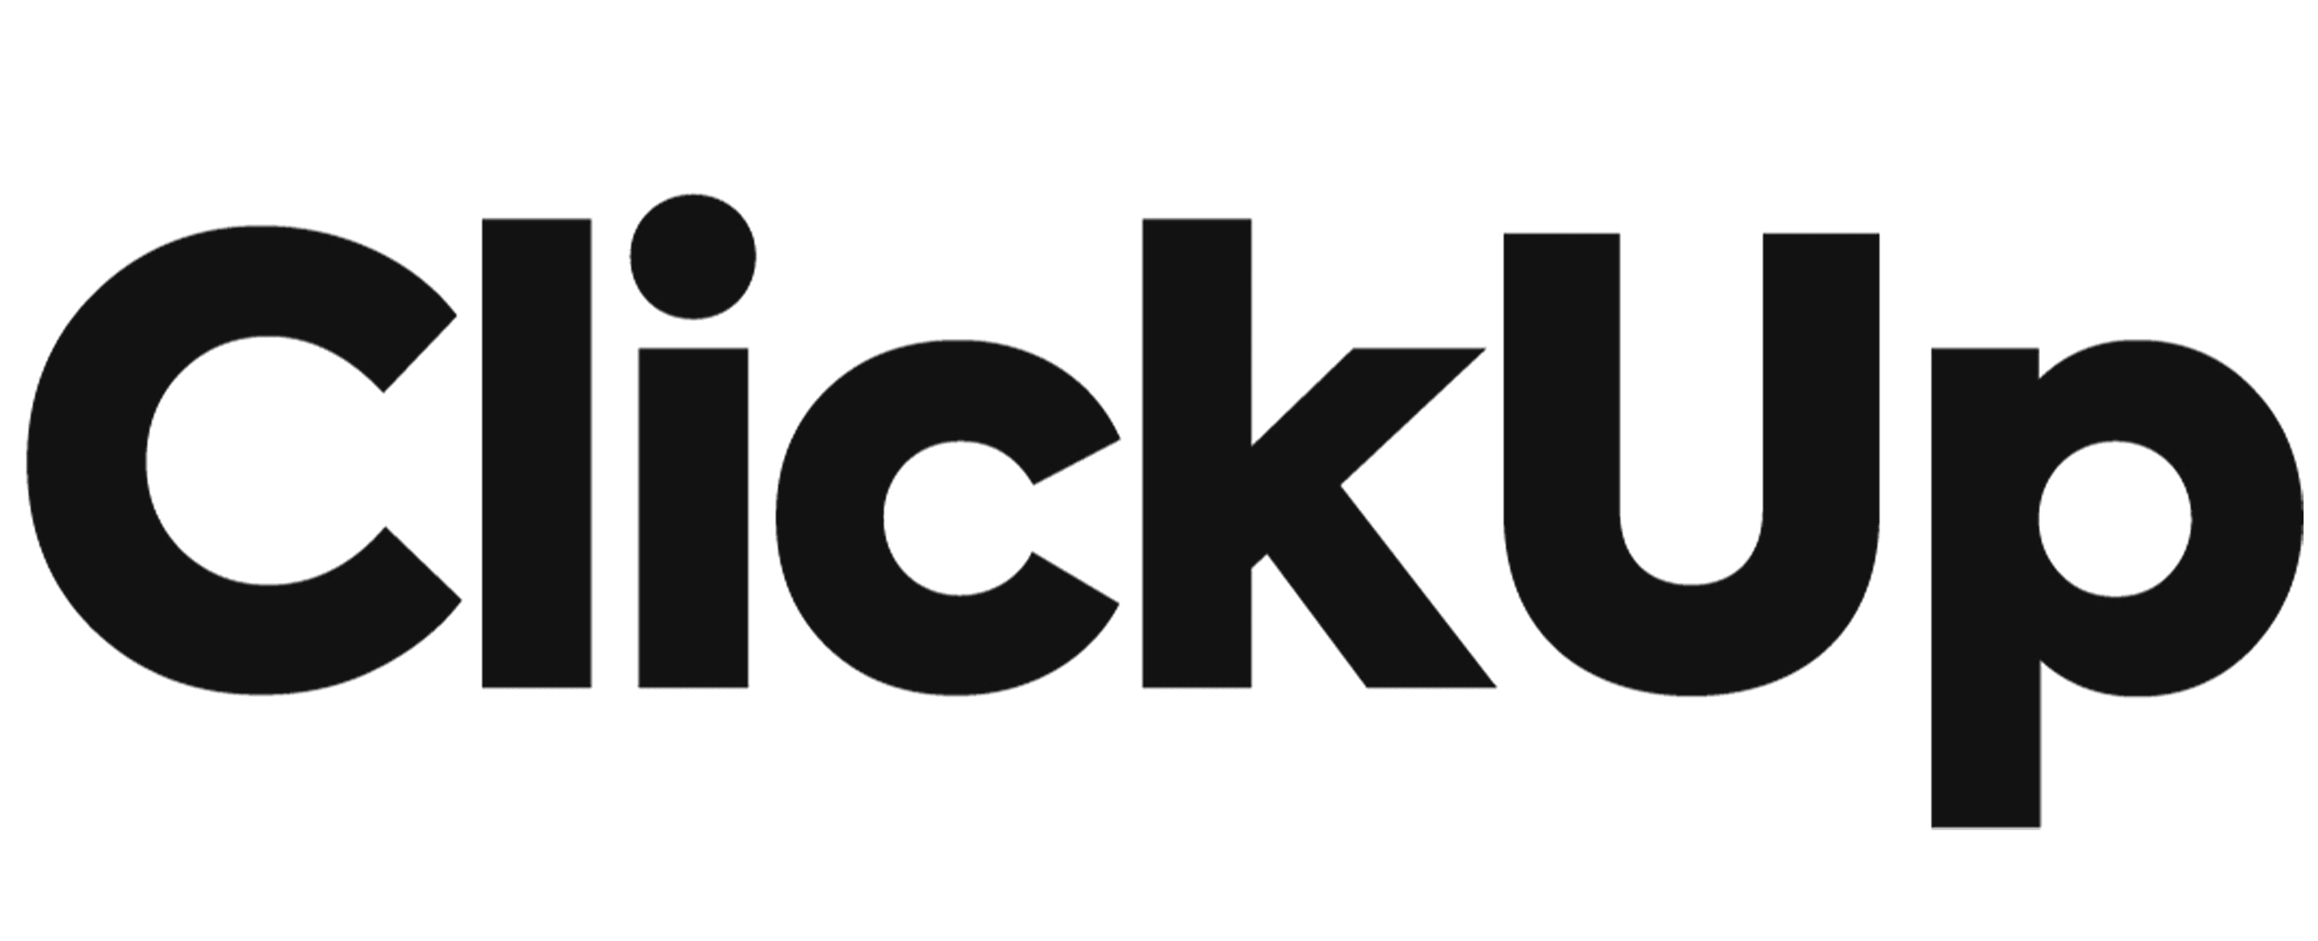
ICT SEMESTER PROJECT

Slide 2
TEAM MEMBERS
Mahrukh Shariq
Falah Hilal
Kashmala Saghar

Slide 3
CONTENT
WHAT IS CLICK-UP
PURPOSE
FUNCTIONALITY
ADVANTAGES
LIMITATION

Slide 4
WHAT IS CLICKUP?

Slide 5
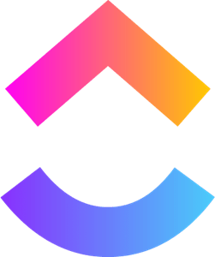
A centralized platform for teams to collaborate and manage their work.
An app to create tasks, assign them to team members, and track your progress.
A cloud-based collaboration and project management tool

Slide 6
WHAT IS THE PURPOSE OF CLICKUP?

Slide 7
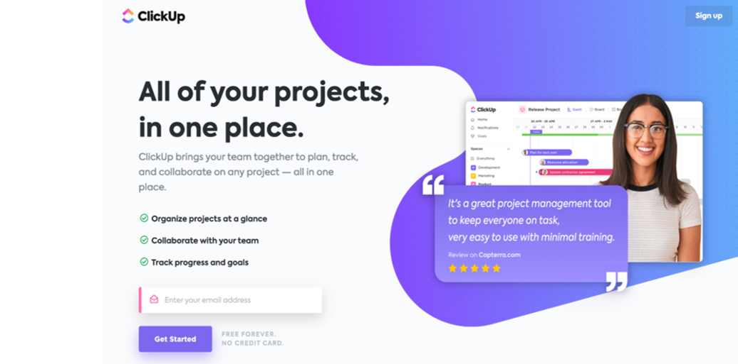
Helps keep all project-related information in one place by providing a centralized hub.

Slide 8
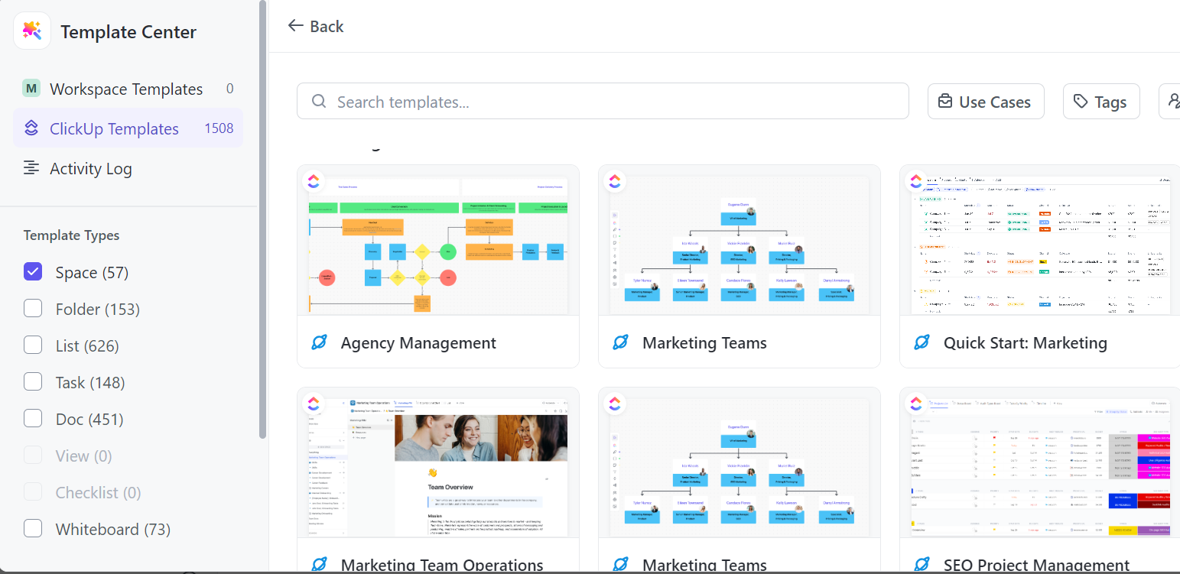
Accommodates different types of projects and workflows by providing a customizable work environment.

Slide 9
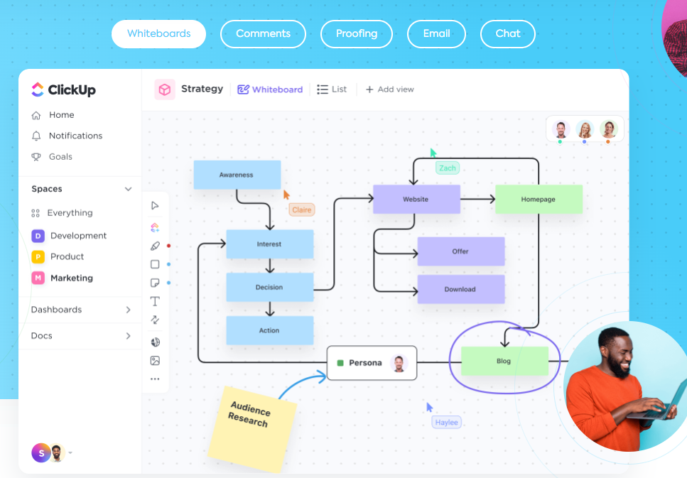
Increase collaboration between team members using built-in communication tools.

Slide 10
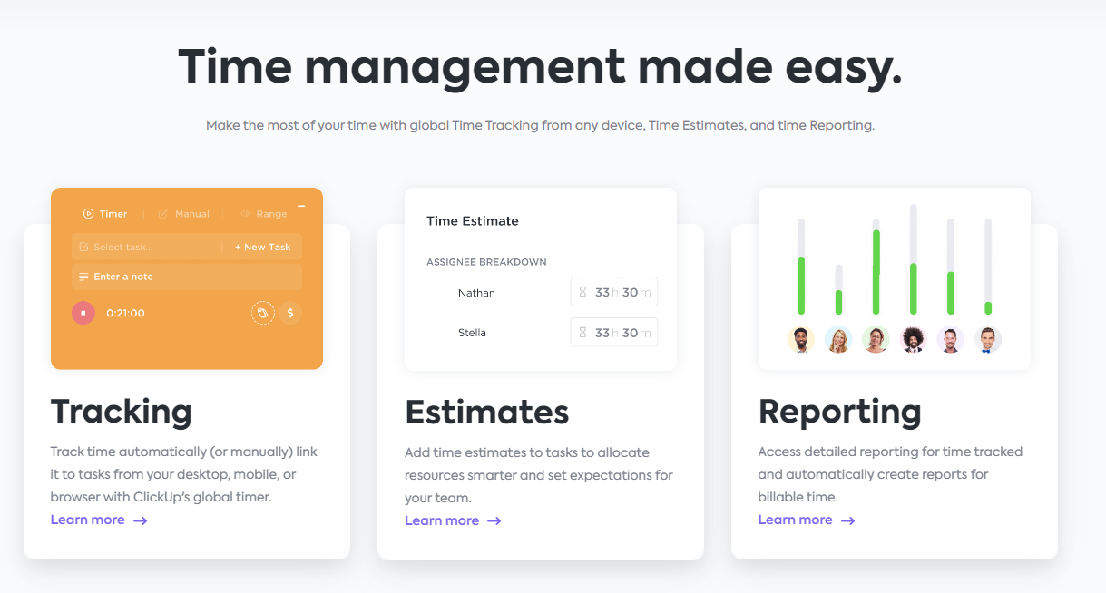
Increase productivity with the help of features such as time tracking, goal setting, and priority management.

Slide 11
FUNCTIONALITY

Slide 12
Project Management
In the realm of project management, the system excels in its ability to systematically organize tasks into projects and folders, providing a structured framework for effective collaboration.

Slide 13
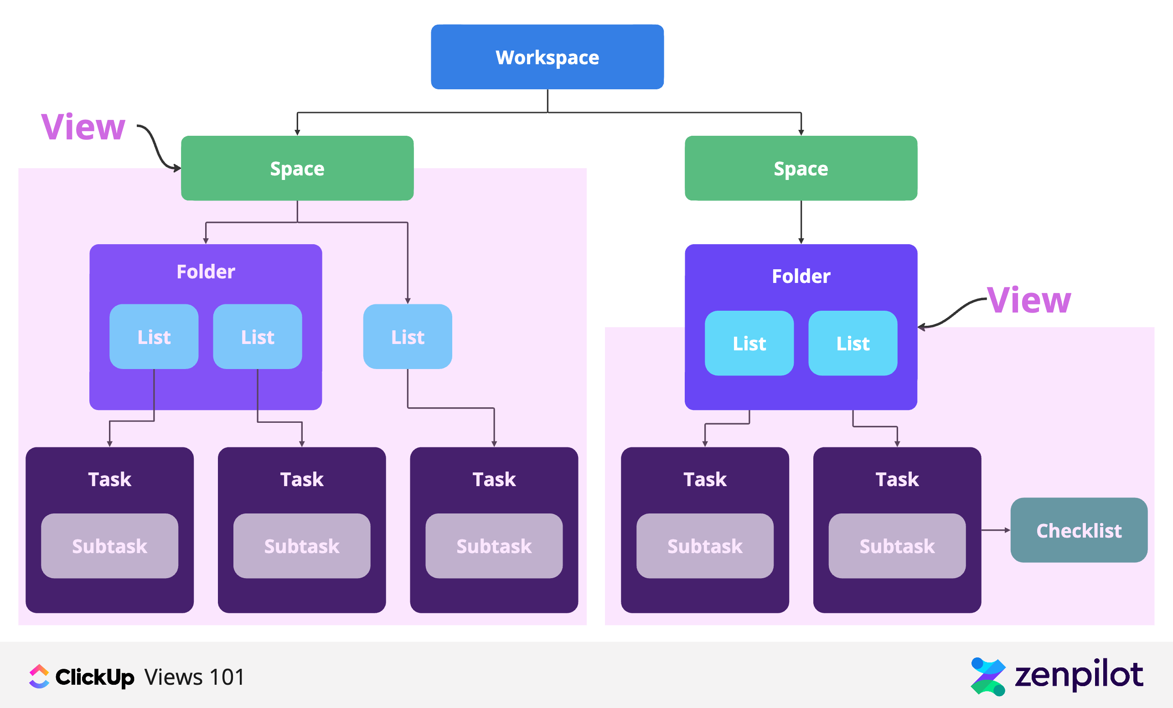
THE HIERARCHY SYSTEM

Slide 14
Task Management
The system enables the creation of tasks and subtasks, assigning responsibilities to team members, and establishing due dates and priorities for each task. The system also allows for seamless storage and sharing, and real-time collaboration on documents.

Slide 15
Analytics
In the realm of reporting and analytics, the platform offers robust features for generating insightful reports on task and project progress. This includes tools to analyze team performance, track time spent on tasks and projects, and generate detailed time reports for comprehensive analysis.

Slide 16
Customization
Customization is a key strength, with the ability to tailor layouts to individual preferences. The creation of custom fields facilitates the capture of specific information relevant to the organization's unique needs. Permissions can be finely customized to control access to features and data, ensuring data security. The system's customizable integration capabilities extend to popular third-party tools and services such as Google Drive, Slack, GitHub, and more.

Slide 17
ADVANTAGES OF CLICK-UP

Slide 18
ENHANCED TEAM COLLABORATION
Advanced communication tools like Chat view, Email integration, multiple assignees, Watchers, and more foster collaboration, particularly beneficial for remote teams.

Slide 19
Real-Time Reporting:
Utilizing over 50 widget variations, ClickUp empowers users to create personalized Dashboards, offering detailed insights into team performance, workload, goals, and milestones

Slide 20
Efficient Time Tracking
Click-Up supports effective time management through flexible tracking features, including notes, labels, billable time, sorting, and filtering.

Slide 21
Budget-Friendly Pricing:
Click-Up offers competitive pricing plans, including a Free Forever Plan and affordable paid options starting at $5 per user per month, making it a suitable choice for diverse budgets and company sizes.

Slide 22
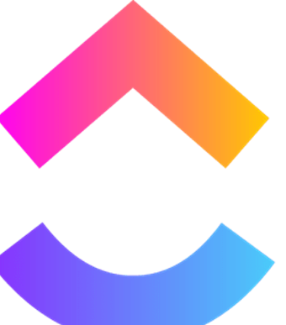
LIMITATIONS
Steep Learning Curve for new users
Complex Interface
Mobile App Limitations
Performance Issues
Customization Complexity

Slide 23

Be organized, efficient, and productive using

